Slide 1
Internal Writing Structures

Slide 2
Thesis Statements

Slide 3
Thesis Structure
Subject
Position
Points (or Importance)
EXAMPLES:
“Tacos are the best food for making a good impression at parties because they’re portable, customizable, and you choose how many or few you eat without waste.”
“Tacos, universally beloved by most party-attendees, are the best choice for party food, especially if you want to make a good impression.

Slide 4
High School Thesis Issues
EXAMPLE:
“High School education has several problems which must be solved in order to prepare America’s youth for the challenges of the 21st-century, namely overcrowding, increasing crime, and lack of tech.”
Issues:
lack of cohesion or relationship between topics
leaves no room for disagreement
topic is too general
vague wording
States the obvious
Notes:
Start with Lack of Cohesion: overcrowding is a problem with numbers of people, crime is about behaviors or people, and technology is about the resources people have access to. But other than them all being problems, the relationship between each of this issues is incredibly broad, and is unlikely to be covered in an essay of the length we write in this course, or in your high school courses. Additionally, the link between the topics suggests that these are the only problems with high school education, and yet it seems that the thesis hasn’t actually covered much ground. So it’s both too broad to be useful, and not comprehensive enough to be considered thorough. It also doesn’t leave much room for disagreement. Thesis statements should be debatable, which means that a reasonable person with a reasonable opinion on the subject could disagree with your claims.

Slide 5
Instead, Try This
Structure:
Specific topic + debatable view + significance to audience
EXAMPLE:
“Solving the problem of overcrowding would allow more students to get the instruction they need to become productive members of society, which is the most important goal in education in America today.”
FIXES:
Develops a single idea in depth
A rational disagreement would be about the goal of education in America, or about which problem needs to be solved first.
Direct cohesion between the problem and the solution
Notes:
Specificity depends on the size of the essay The position is more clear because we know what the end goal of the argument is. There’s a cause and effect relationship clarified in the thesis, which can also indicate the structure or pattern of the essay the writer intends to use.

Slide 6
Structure & Thesis
A thesis provides the reader with an overview of the structure and the rhetorical pattern of writing
Keywords and verbs provide clues to pattern
General or specific points hint at the roadmap
But in order for our thesis to guide our structure, we need to know what thinking is expected of us
Sometimes you’ll get this information from a prompt, telling you to write a comparison/causal analysis/etc
Other times, you’ll only get key words: discuss the effects of… talk about the benefits of… Why does….
Notes:
Let’s revisit this thesis:
“Solving the problem of overcrowding would allow more students to get the instruction they need to become productive members of society, which is the most important goal in education in America today.”
What kind of thinking does this thesis suggest we need to focus on?

Slide 7
How the thesis affects organization
5 paragraph essay:
Education in America is facing a lot of issues.
Overcrowding interferes with instruction.
Increasing crime in schools makes students unable to work.
Lack of technology means students are not prepared for the work force.
Conclusion: I’ve talked about three points and these points, shockingly, still matter and are, like, totally connected.
Notes:
Notice that the conclusion becomes difficult to write because we haven’t yet clarified the relationship between the ideas in the thesis and its goals.

Slide 8
How the thesis COULD affect organization
The better essay, focused on several patterns as necessary- causes, effects, process, and on argument:
The primary goal of a high school education is to make all students productive members of society [argument]
Productive members of society need jobs, but as jobs become more competitive, more people need and seek higher education [cause]
At the same time, budget cuts mean fewer teachers in schools, which overcrowds classrooms and reduces the quality of instruction [effect]
Teachers get burned out when classes are overcrowded [effect]
In overcrowded classrooms, too many students slip through the cracks [effect]
Conclusion suggesting what the result of solving the problems might mean for society (looks forward)
http://web.csulb.edu/~eguzik/fivepara.html

Slide 9
Thesis Statement Practice

Slide 10
How to do this on your own
GENRE: Major goals & Situations
STRUCTURE: elements of the pattern, conventions,& organization

Slide 11
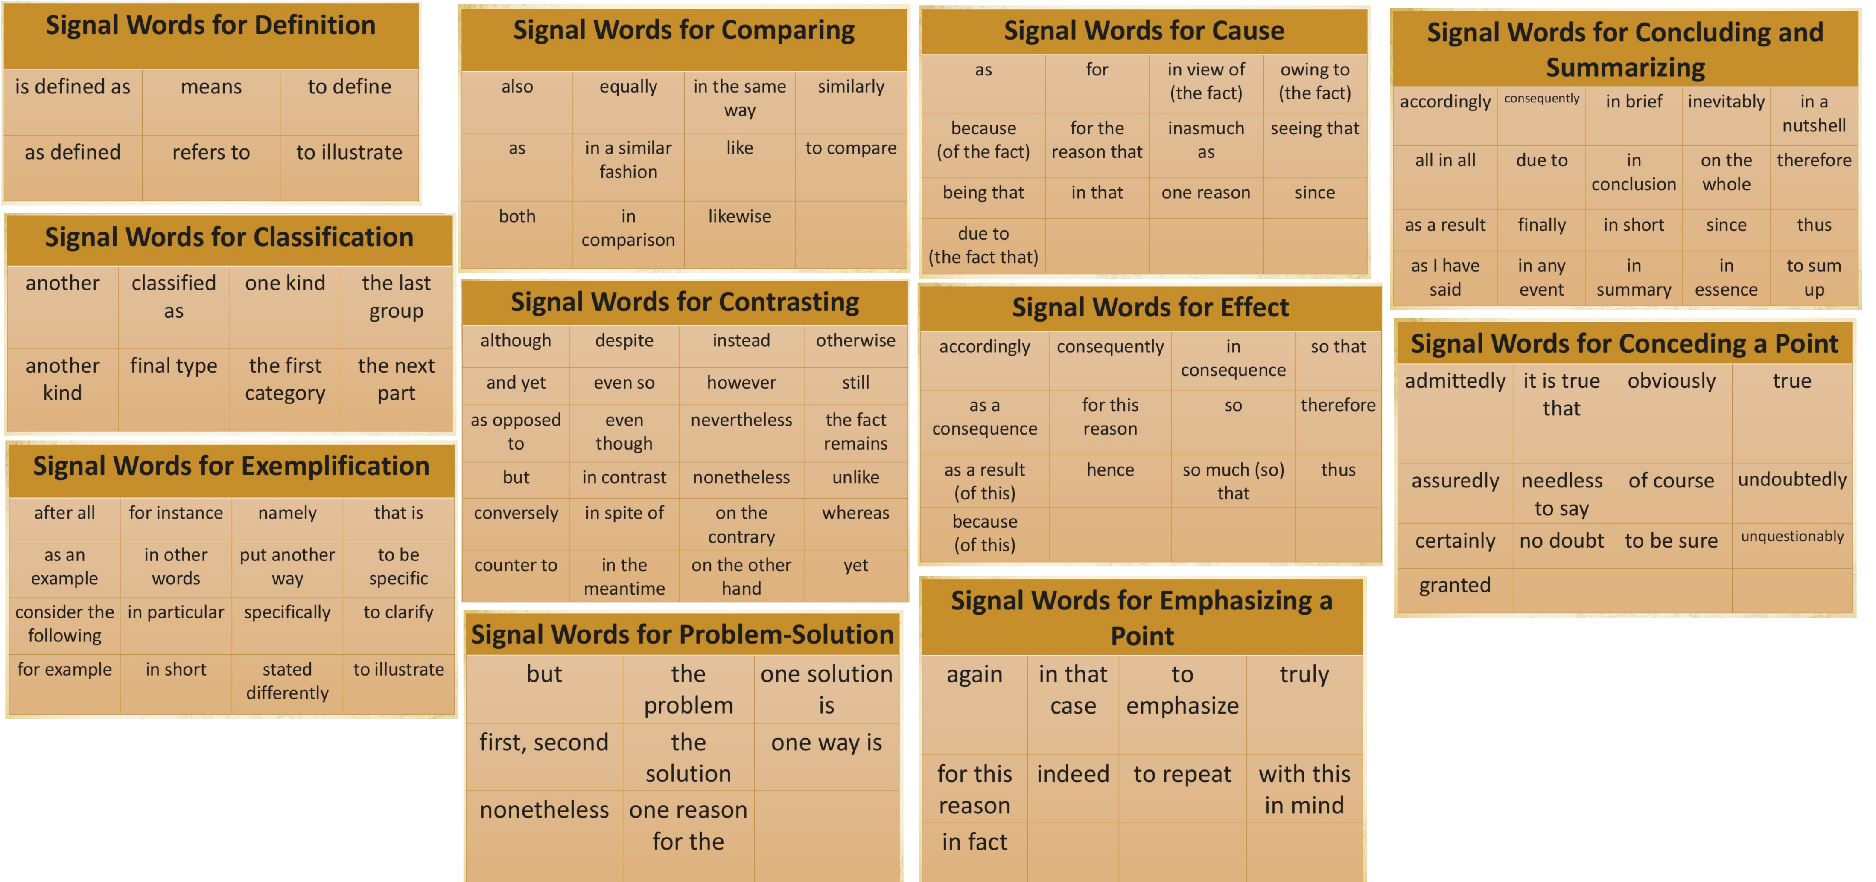
KEYWORDS BY RHETORICAL PATTERN

Slide 12
MINUTE THESIS ACTIVITY!!!

Slide 13
Topic Sentences

Slide 14
Topic Sentences
The first sentence of a paragraph
Each paragraph should cover a single idea
Large ideas should be broken down into separate paragraphs, smaller parts of a big idea
Sometimes body “sections” are more appropriate than body “paragraphs”
And that’s why topic and linking sentences are so important
The reader unconsciously uses keywords in your topic sentences to decide where they are in the argument and what they can expect to come next.
Notes:
Topic Statements function like mini thesis statements for each paragraph. They help clarify and link the content for the reader.

Slide 15
Topic Sentences
Are always a statement of the writer’s belief
Never a fact
Never a quote
Never a question
Usually provides a transition from the previous ideas to the new ideas.
They should avoid stating the obvious, so as not to bore the reader.
Notes:
Avoid writing like “In this paragraph, I will cover…”

Slide 16
From Thesis to Topic Sentence
The better essay, focused on causes, effects, process, and on argument:
Intro/Thesis: The primary goal of a high school education is to make all students productive members of society [argument]
Productive members of society needs jobs, but as jobs become more competitive, more people need and seek higher education
At the same time, education is experiencing budget cuts leading to fewer teachers in schools.
A lack of instructors causes overcrowding and reduces the quality of the instruction [effect]
Teachers get burned out when classes are overcrowded
In overcrowded classrooms, too many students slip through the cracks
Conclusion: Solving the issues within our American classrooms can make high schools more capable of providing students the education they need to become productive members of society.
http://web.csulb.edu/~eguzik/fivepara.html

Slide 17
Topic Sentence Practice

Slide 18
Topic Sentence Practice #1
Highlight your thesis statement
Highlight the first sentence of every body paragraph
Read ONLY those sentences

Slide 19
Topic Sentence Practice #2 Which of the following would NOT be an appropriate topic sentence?
I am going to explain how self-driving cars are better for the environment.
There are many possible contributing factors to global warming.
Teen pregnancy rates may be prevented by improved sex education.
The first true fax machines appeared in the 1840s.
Remodeling a kitchen successfully requires research and a good eye.
Researchers suggest that bees seek out honey in four different ways.

Slide 20
How to Fix the Issues
Make it Thorough (But brief)
The first true fax machine appeared in the 1840s.
Technological advancements in the 1840s created a need for faster communication and ushered in the first true fax machines.
✓ clarifies the topic and goal of the paragraph
Make it precise
I am going to explain how self-driving cars are better for the environment.
While self-driving cars do not eliminate pollutants, their improved efficiency is a huge step toward a cleaner future.
✓ is no longer obvious

Slide 21
How to Fix the Issues
Make it your own
Researchers suggest that bees seek out honey in four different ways.
It’s important to understand the various systems bees use to locate honey before we try to replicate them.
✓comes from the perspective of the writer
✓clarifies a pattern
Make it new
There are many possible contributing factors to global warming.
The dizzying array of possible contributing factors to global warming are part of the reason that most people don’t study the science in their spare time.
✓clarifies a pattern ✓ belief-based ✓application

Slide 22
Linking Sentences Regardless of how good your defense is, readers will lose interest if you don’t address why your argument matters
Who Cares? (identify a person or group of readers)
Can help create dramatic tension between views that readers will want to see resolved in your writing
So What? (real-world applications and consequences)
Helps when readers may not feel invested in a clashing of views.
Appeal to something that your actual audience already cares about, or some larger matter that readers deem important

Slide 23
Example
Scientists used to think body fat and the cells it was made of were pretty much inert, just an oily storage compartment. But within the past decade research has shown that fat cells act like chemical factories and that body fat is potent stuff: a highly active tissue that secretes hormones and other substances with profound and sometimes harmful effects…In recent years, biologists have begun calling fat an “endocrine organ,” comparing it to glands like the thyroid and pituitary, which also release hormones straight into the bloodstream. Researchers trying to decipher the biology of fat cells hope to find new ways to help people get rid of excess fat or, at least, prevent obesity from destroying their health. In an increasingly obese world, their efforts have taken on added importance.

Slide 24
Transitions

Slide 25
Transitions
…establish logical connections between sentences, paragraphs, and sections of your papers.
…tell readers what to do with the information you present to them.
https://writingcenter.unc.edu/tips-and-tools/transitions/

Slide 26
Transitions are found…
Between large sections of content
To summarize and/or preview
Between paragraphs
Highlight relationships that exist between content
Within paragraphs
Cues to help readers understand information

Slide 27
Organization of Ideas
the order in which you have chosen to present the different parts of your discussion or argument
the relationships you construct between these parts.
Transitions cannot substitute for good organization, but they can make your organization clearer and easier to follow.

Slide 28
Example
Scientists used to think body fat and the cells it was made of were pretty much inert, just an oily storage compartment. But within the past decade research has shown that fat cells act like chemical factories and that body fat is potent stuff: a highly active tissue that secretes hormones and other substances with profound and sometimes harmful effects…In recent years, biologists have begun calling fat an “endocrine organ,” comparing it to glands like the thyroid and pituitary, which also release hormones straight into the bloodstream. Researchers trying to decipher the biology of fat cells hope to find new ways to help people get rid of excess fat or, at least, prevent obesity from destroying their health. In an increasingly obese world, their efforts have taken on added importance.

Slide 29
Transition Practice
El Pais, a Latin American country, has a new democratic government after having been a dictatorship for many years. Assume that you want to argue that El Pais is not as democratic as the conventional view would have us believe.
Par. 1: reasons one might consider El Pais democratic
Par. 2: refute the above with reasons it’s not democratic
The transition will need to indicate to readers that the second paragraph is a contradiction of the first.

Slide 30
Which of the following categories would be appropriate for the transition?
Change in time
Additional Information
Contrast
Comparison
Illustration
Location
Causation
Effects
Summary
Clarification

Slide 32
Examples of Transitions that Signal Contrast
Despite the previous arguments…
However, we should also consider…
Regardless of the above examples..
On the other hand…

